Slide 1
Lecture 12
Blueprints in Action 3

Slide 2
Lecture Goals and Outcomes
The goals of this lecture are to
Present a variety of Blueprint functions
Explain the Set Input Mode Game And UI function
Show how to create a random point in a bounding box
Explain the Select node
By the end of this lecture you will be able to
Use the modulo (%) operation and the Clamp function
Change a Material using a Blueprint function
Change the input mode
Use the Select node with various index types

Slide 3
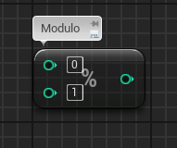
Modulo (%)
The modulo operation, represented by the percentage symbol, returns the remainder of a division.
Input
A: Value to be divided.
B: Value that will be used as the divisor.
Output
Return Value: Remainder of the division.
Example
1 % 3 = 1
2 % 3 = 2
3 % 3 = 0
4 % 3 = 1
5 % 3 = 2
6 % 3 = 0

Slide 4
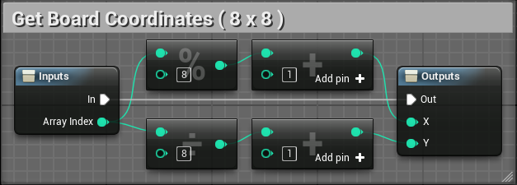
Modulo (%): example
It is common to use the modulo operation to convert the index of a one-dimensional array into a two-dimensional coordinate.
In the example on the right, an array of integers is being used to represent a chessboard. The array contains 64 positions, so its indexes range from “0” to “63”. Each position of the board is represented by a coordinate (X, Y).
The first position has coordinates (1, 1), and the last position has coordinates (8, 8). The macro seen in the example converts an array index to the X and Y coordinates of the board.

Slide 5
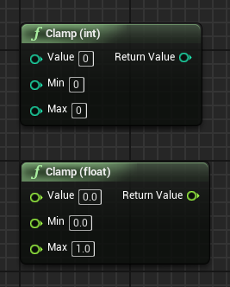
clamp
A Clamp function receives an input value and the minimum and maximum values. If the input value is between the minimum and maximum values, it is returned without modification.
If it is below the minimum, the minimum value is returned. If it is above the maximum, the maximum value is returned.
Input
Value: Input value that will be compared with the Min and Max values.
Min: The lowest value that can be returned.
Max: The highest value that can be returned.
Output
Return Value: Value between the Min and Max values.

Slide 6
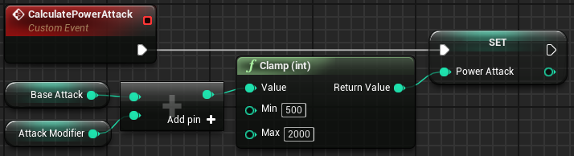
Clamp: example
In the example on the right, there is an event that calculates the value of the power attack of a character. This value is based on the sum of the values of the variables Base Attack and Attack Modifier. The Attack Modifier variable can indicate attack bonuses, or it can have a negative value, indicating some bad state of the character.
But no matter how bad the character’s attack penalties are, the minimum value of the power attack is “500”. Similarly, the maximum value of the power attack is “2000”, even if the sum of the values of the base attack and the attack bonus is higher.

Slide 7
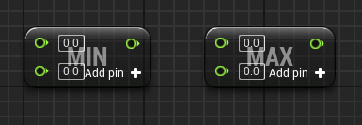
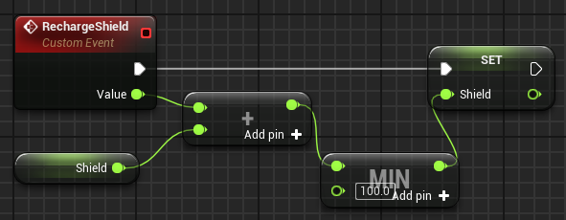
Min and max
The Min function returns the minimum value between the input values. The Max function returns the maximum value between the input values.
Many input values can be added in both functions by using the Add pin button.
Example
In the bottom image on the right, the Min function is being used to ensure that the value of the Shield variable is never greater than “100.0”.

Slide 8
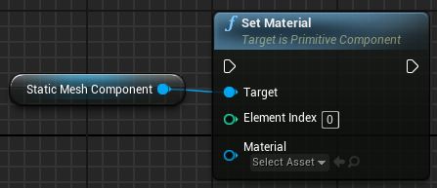
Set material
The Set Material function changes the Material being used by a component.
Input
Target: Primitive component that will have its Material modified.
Element Index: Indicates which Material will be modified in the component.
Material: Reference to the new Material that will be used.

Slide 9
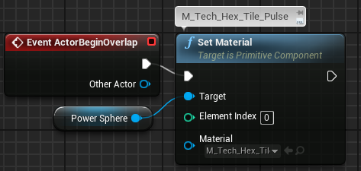
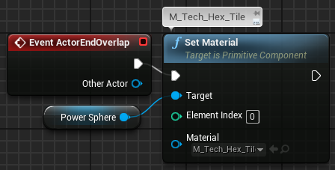
Set material: example
In the example on the right, there is a Blueprint that contains a Static Mesh component called “Power Sphere”. When an Actor approaches the Blueprint, the Power Sphere Material is replaced with T_Tech_Hex_Tile_Pulse to indicate that it is active.
When the Actor moves away, the Material is replaced with M_Tech_Hex_Tile, indicating that the component is disabled.

Slide 10
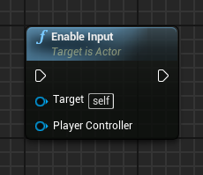
Enable input
The Enable Input function is used to allow a Blueprint to respond to input events such as a keyboard, mouse, and gamepad.
Input
Target: Actor that will have its input enabled. The “self” value is used to target the Blueprint that contains the node.
Player Controller: A reference to the Player Controller in use.

Slide 11
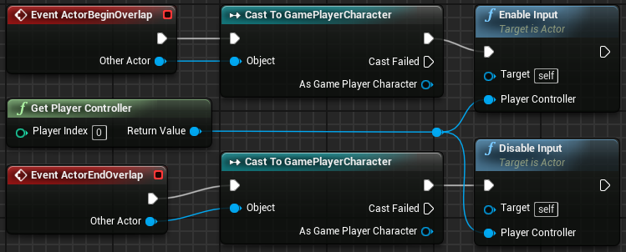
Enable input:
example
In the example on the right, a Blueprint only responds to input events when the player is near it. The player is represented by a Blueprint named “GamePlayerCharacter”. When the player is within the Blueprint’s collision bounds, the Enable Input function is called.
When the player is out of the Blueprint’s collision bounds, the Disable Input function is called so that this Blueprint no longer responds to input events.

Slide 12
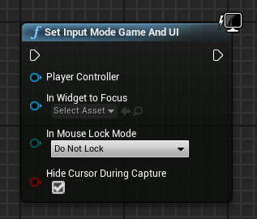
Set Input Mode Game and UI
The Set Input Mode Game And UI function defines an input mode in which the user interface (UI) has priority in handling user input events. If the UI does not know how to handle a particular event, the input is passed on to the Player Controller to be handled.
Input
Player Controller: A reference to the Player Controller.
In Widget to Focus: A reference to a UMG widget that will receive the player’s input first before passing it to the Player Controller.
In Mouse Lock Mode: Indicates how the mouse will be handled.
Hide Cursor During Capture: Indicates whether the mouse cursor should be hidden.

Slide 13
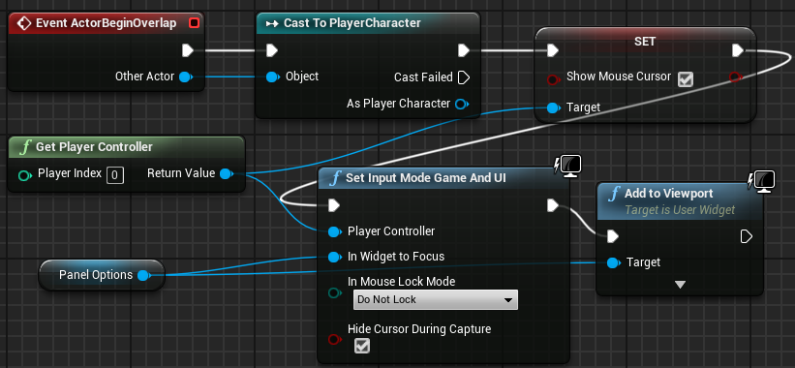
Set Input Mode Game and UI : example
In the example on the right, there is a Blueprint that interacts with the player in a first-person game. When the player overlaps this Blueprint, a UI is displayed with options for the player to choose from using the mouse.
The Show Mouse Cursor property of the Player Controller is set to “true” to display the cursor on-screen.
The Set Input Mode Game And UI function causes the mouse to control the cursor so that it can interact with the panel instead of changing the player’s view.

Slide 14
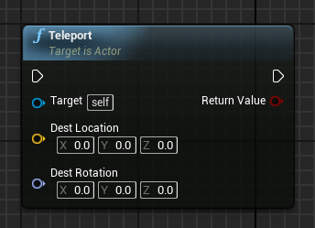
teleport
The Teleport function moves an Actor to the specified location. If there is an obstacle at the location, the Actor is moved to a nearby place where there is no collision.
Input
Dest Location: Destination location.
Dest Rotation: Rotation applied to the Actor.
Output
Return Value: Boolean variable. If the value is “false”, the Actor could not be moved.

Slide 15
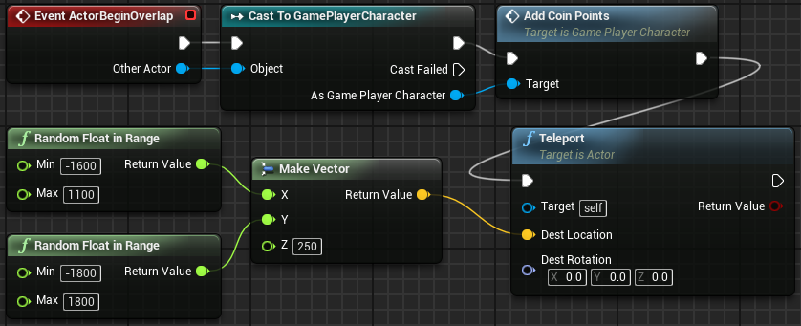
teleport:
example
In the example on the right, there is a game in which the player collects coins. The image shows the ActorBeginOverlap event of the Blueprint that represents the coins.
When the player collects a coin, the Add Coin Points function is called to register the points, and after that the coin is teleported to another location in the playing area.
The playing area has several obstacles, but the Teleport function will place the coin in a free place.

Slide 16
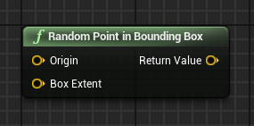
Random Point in Bounding Box
The Random Point in Bounding Box function returns a vector representing a random point located within a volume specified by an origin point and a box extent.
Input
Origin: Vector representing the central position of the box extent.
Box Extent: Vector that contains the dimensions of the box that defines the 3D volume.
Output
Return Value: Vector representing a point that was generated randomly inside the defined box extent.

Slide 17
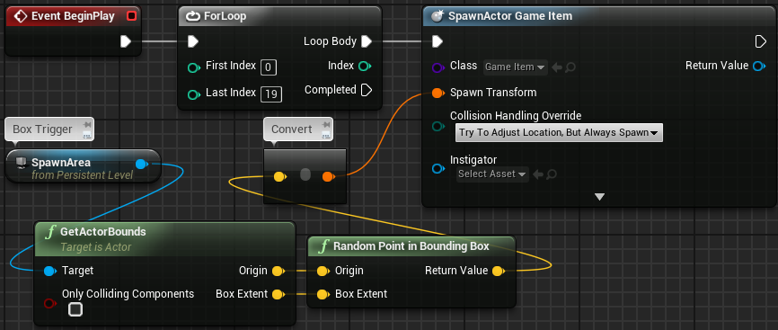
Random Point in Bounding Box:
example
The image on the right is from a Level Blueprint. A Box Trigger named “SpawnArea” has been placed in the Level to define an area in which items will be created at random positions.
When the game starts, the ForLoop node executes the SpawnActor node 20 times to create 20 items in random positions.
The position of each item is determined by the Random Point in Bounding Box function using the origin point and box extent specified for the spawn area.

Slide 18
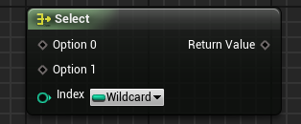
select
The Select node returns a value associated with the options that corresponds to the index that is passed as input. The Select node is generic and can work with several types of variables for the index and for the values of the options. To change the type of the options or the index, right-click on the parameter and choose “Change Pin Type”. You can also set the pin type by dragging a variable reference or wire onto the pins. To add more options, right-click on the node and choose “Add Option Pin”.
Input
Option 0, 1, …: Values that can be returned by the Select node. The options can be of any type.
Index: Value that will determine the option to be returned. The type can be “Boolean”, “Byte”, “Integer”, or “Enum”.
Output
Return Value: The option indicated by the Index parameter.

Slide 19
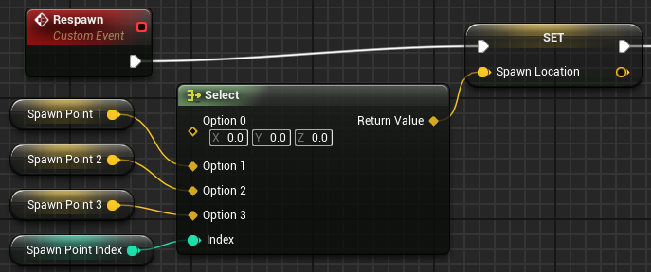
Select:
Example 1
In the Respawn event seen in the image on the right, the Select node is being used to get the location of a spawn point based on the value of the integer variable Spawn Point Index.
If the value of Spawn Point Index is “0”, it will return “(0,0,0)”. If the value is “2”, it will return the value of the Spawn Point 2 variable.

Slide 20
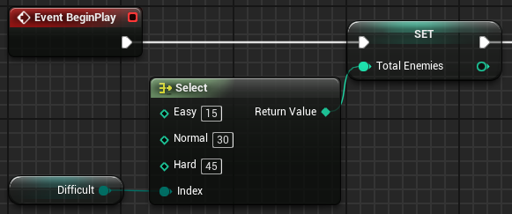
Select:
Example 2
In the example on the right, the index is an enum called “Difficult” that contains the Easy, Normal, and Hard values.
The type of the options is “Integer” and represents the number of enemies according to the value of the Difficult enum variable.

Slide 21
summary
This lecture presented various Blueprint functions.
It showed how to change the input mode, create random points, change a Material, and use the Select node.

